Slide 1
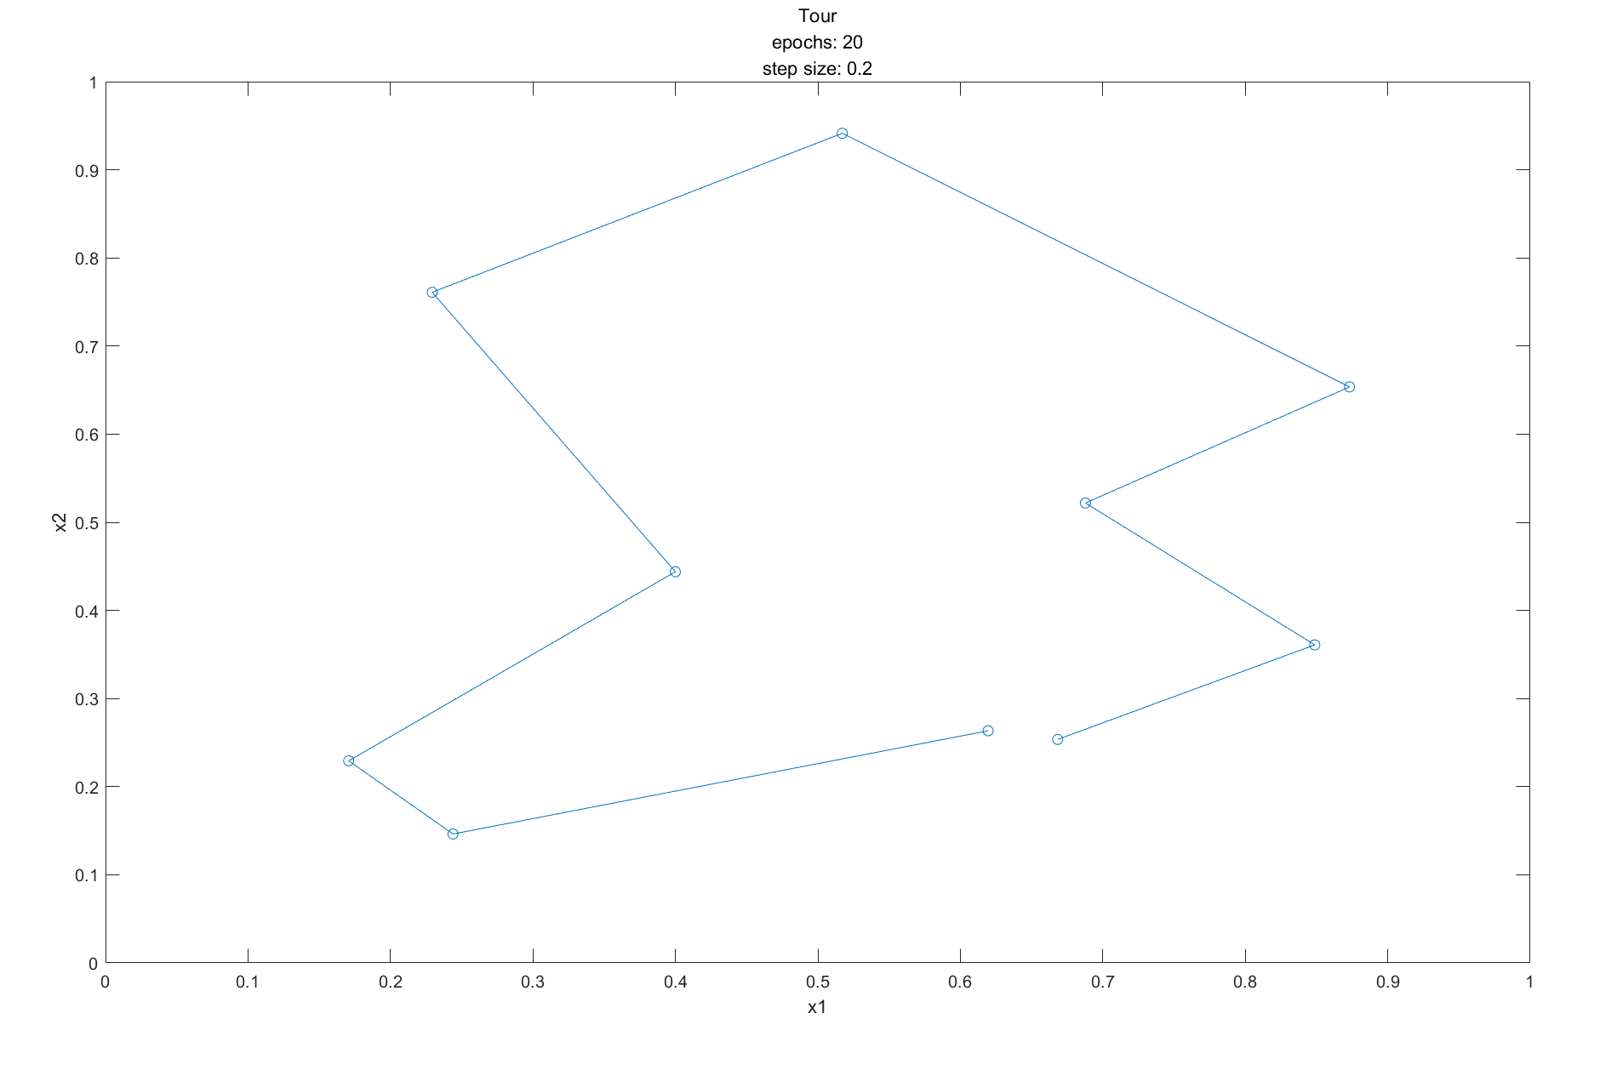
Cyclic tour
Figure X: A fairly short route found by the SOM algorithm. (20 epochs)
The initial size of the neighborhood is 2, decayed by 0.8.
The step size is 0.2.

Slide 2
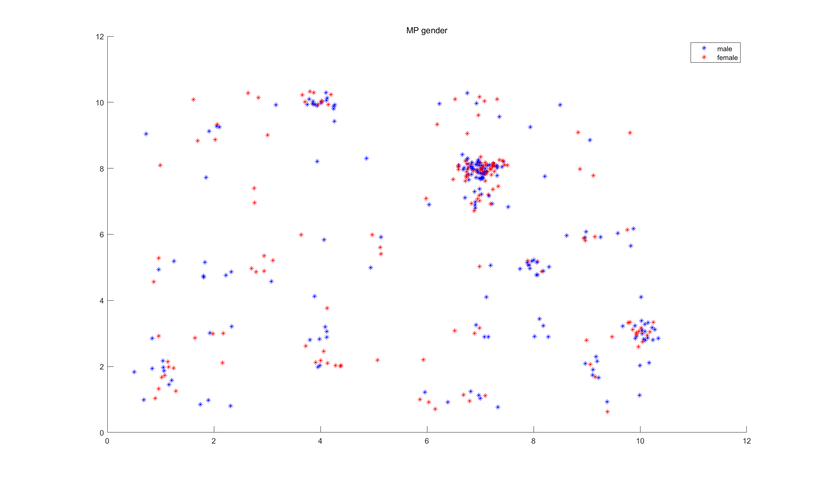
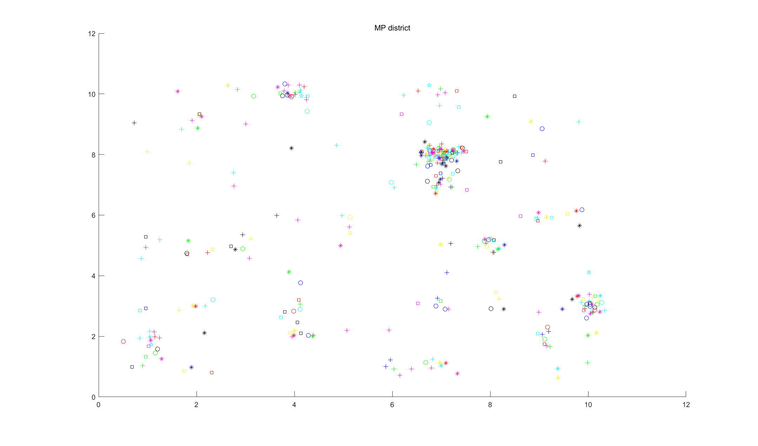
Clustering with SOM
The initial size of the neighborhood is 5, decayed by 0.8.
The step size is 0.2.
20 epochs
Figure Y: Position of all MPs with respect to gender, district.
gender and district might not have a significant effect on the votes of the MPs.

Slide 3
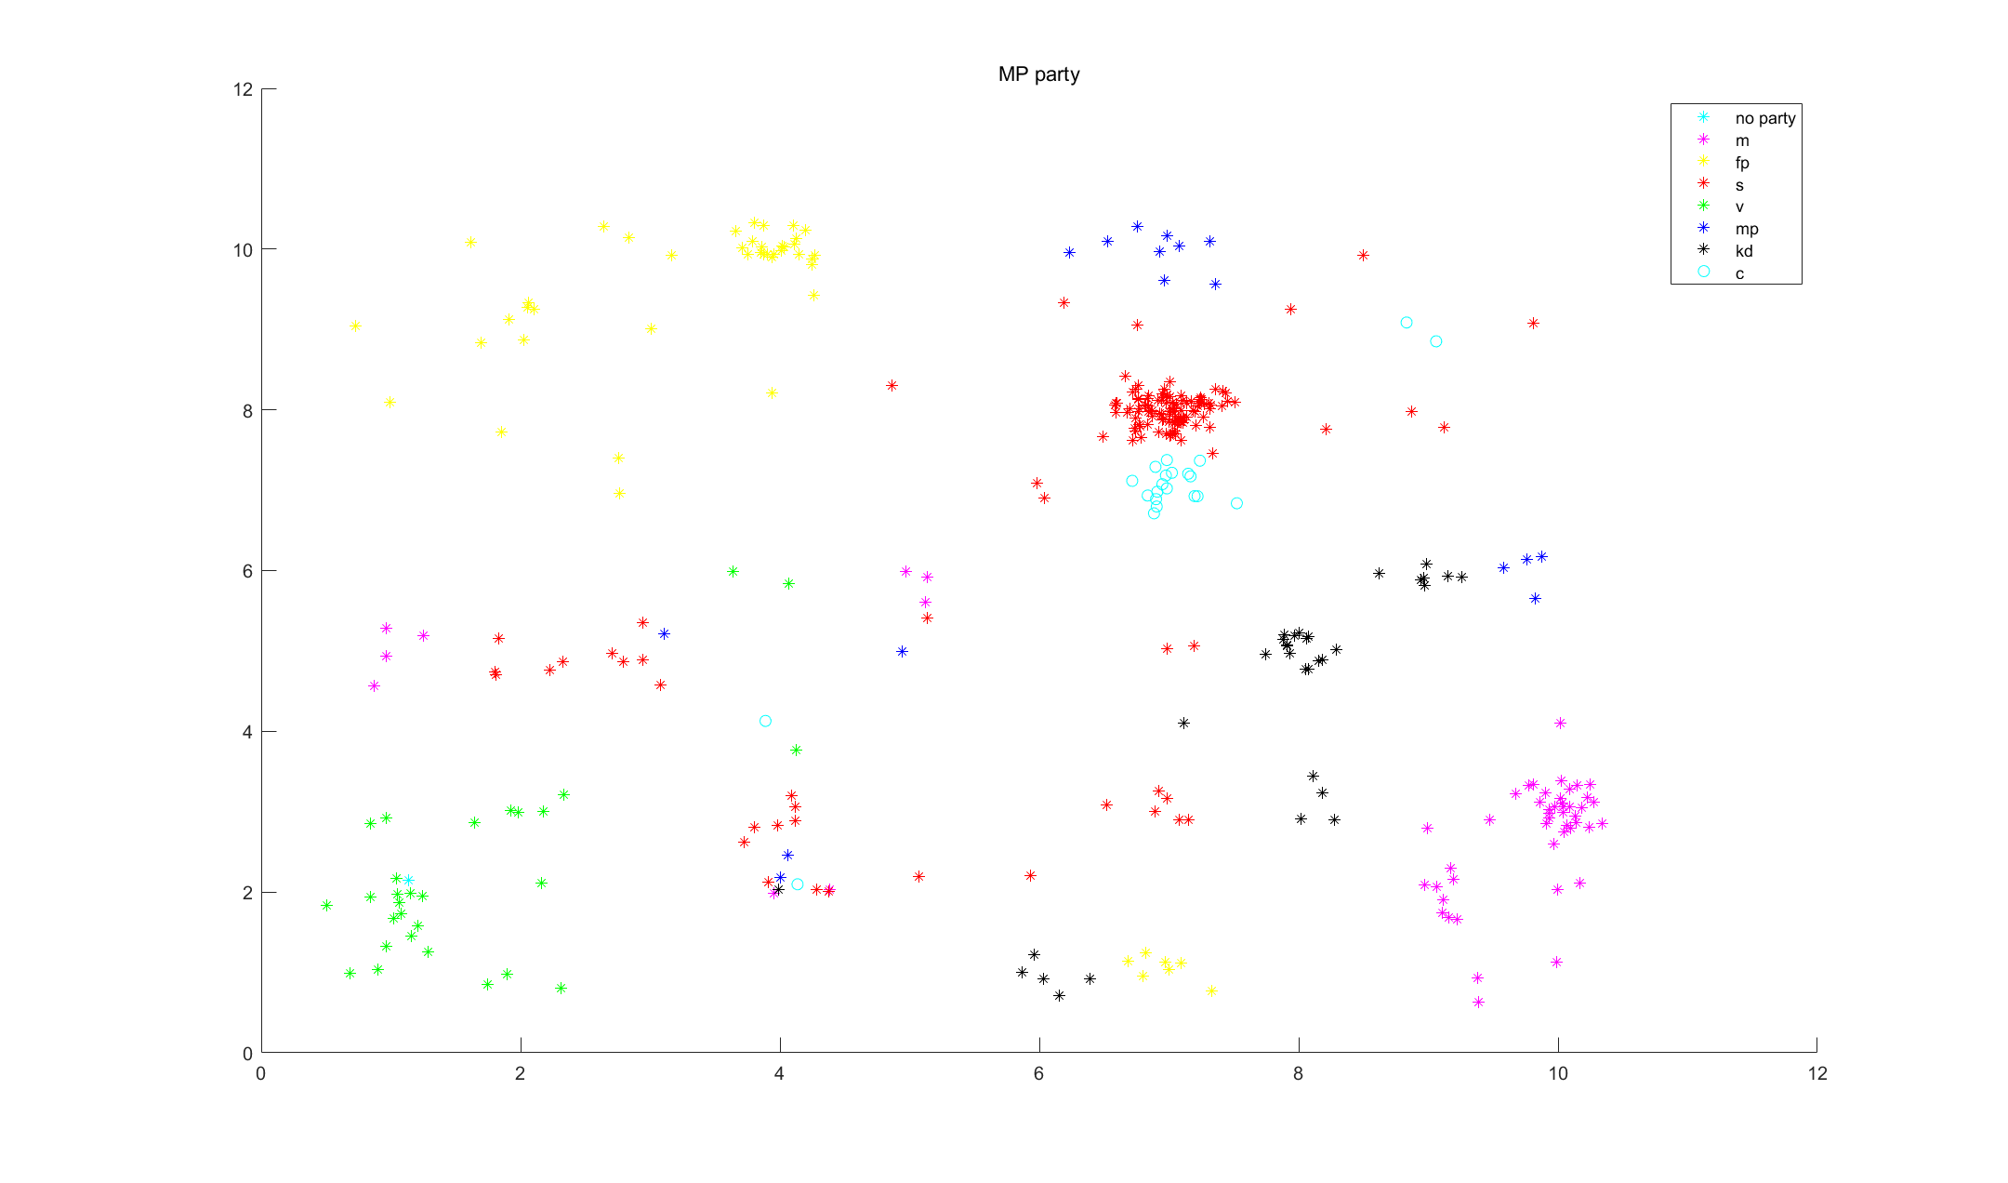
Clustering with SOM
Figure Y: Position of all MPs with respect to party.
The votes of the MPs should depend on the party since for the same party the points are close to each other.

